Slide 1
Grammar and Context Free Grammar
presented by Hanseeka Dhingana

Slide 2
Grammar
Standard way to representing language.
Defined as quadruple:
G = { V, T, P, S }

Slide 3
Grammar
V → (variable or nonterminal) | Denoted as a capital letter.
T → (Terminal) | Denoted as small letter, to define the string
P → (Production Rule) | Specify how nonterminal can be replaced with other non terminal or terminals. e.g. S → a S b / ε
S → (start) | A special nonterminal from which derivation begins

Slide 4
Context Free Grammar
A context free grammar is a formal system used to describe the context free language.
It list all strings in language using a set of rules (production rules)
It extends the capabilities of regular expressions and finite automata

Slide 5
Context Free Grammar
Formal definition of CFGs is:
CFG : (V, T, P, S)
V → finite set of variables (nonterminal)
T → finite set of terminals (V ∩ T = θ )
P → Production Rule
S → Start variable

Slide 6
Variable and Terminals
Variable:
They help in defining the structure of the grammar
It is represented by uppercase letters (e.g. S, A, B)
They are replaced using production rule.
Terminals:
Symbols that appear in the final strings of the language.
They are usually represented by lowercase letter (e.g. a, b, c)
It can’t be further replaced.

Slide 7
Why CFGs
Nested (Recursive) structures
Hierarchical Grouping

Slide 8
Designing of CFG
Identify the language you want
First, decide exactly what strings your grammar should generate.
Example: all strings of matched parentheses, like (), (()), ()(), etc
2. Base Case
Your base case is the simplest string(s) in the language, where recursion stops.
For matched parentheses, the simplest valid string is the empty string
In CFG we write it as S → ε

Slide 9
Designing of CFG
3. Recursive Rules
Write recursive rules that build larger strings by referring back to your start symbol (or other non terminals)
Every valid string of language is written in the recursive rule.
For parentheses
S → (S)
S → SS
4. Putting It All Together
S → ε
S → (S)
S → SS

Slide 10
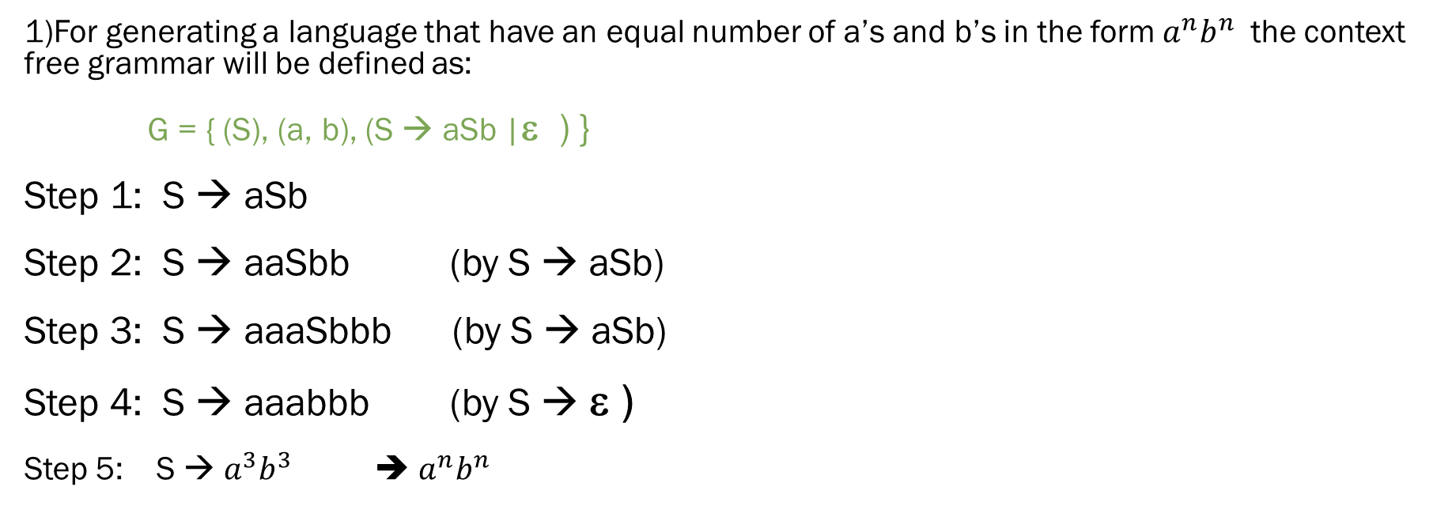
Example
1)For generating a language that have an equal number of a’s and b’s in the form $a^{n}b^{n}$ the context free grammar will be defined as:
G = { (S), (a, b), (S → aSb |ε ) }
Step 1: S → aSb
Step 2: S → aaSbb (by S → aSb)
Step 3: S → aaaSbbb (by S → aSb)
Step 4: S → aaabbb (by S → ε )
Step 5: S → $a^{3}b^{3}$ ➔ $a^{n}b^{n}$

Slide 11

Example
1)For generating a language that have an equal number of a’s and b’s in the form $a^{n}b^{n}$ the context free grammar will be defined as:
Context-free grammar:
S → aSb | ε
OR
S → aSb
S → ε

Slide 12
Example
Write a CFG for all strings of balanced parentheses:
Example: (), (()), ()(), etc
3) Write a CFG for the language of all strings over {a,b} such that the string is a palindrome.
Example: abba, aba, aa, etc

Slide 13
Example
Write a CFG for all strings of balanced parentheses:
Example: (), (()), ()(), etc
Context-free grammar is : S → ε
S → (S)
S → SS
3) Write a CFG for the language of all strings over {a,b} such that the string is a palindrome.
Example: abba, aba, aa, etc

Slide 14
Example
3) Write a CFG for the language of all strings over {a,b} such that the string is a palindrome.
Example: abba, aba, aa, etc
Context-Free Grammar : S → aSa | bSb | a | b | ε

Slide 15
Application
Programming‑Language Parsers and Compilers
Natural‑Language Processing (NLP)
Interactive Editors and IDEs

Slide 16


Slide 17
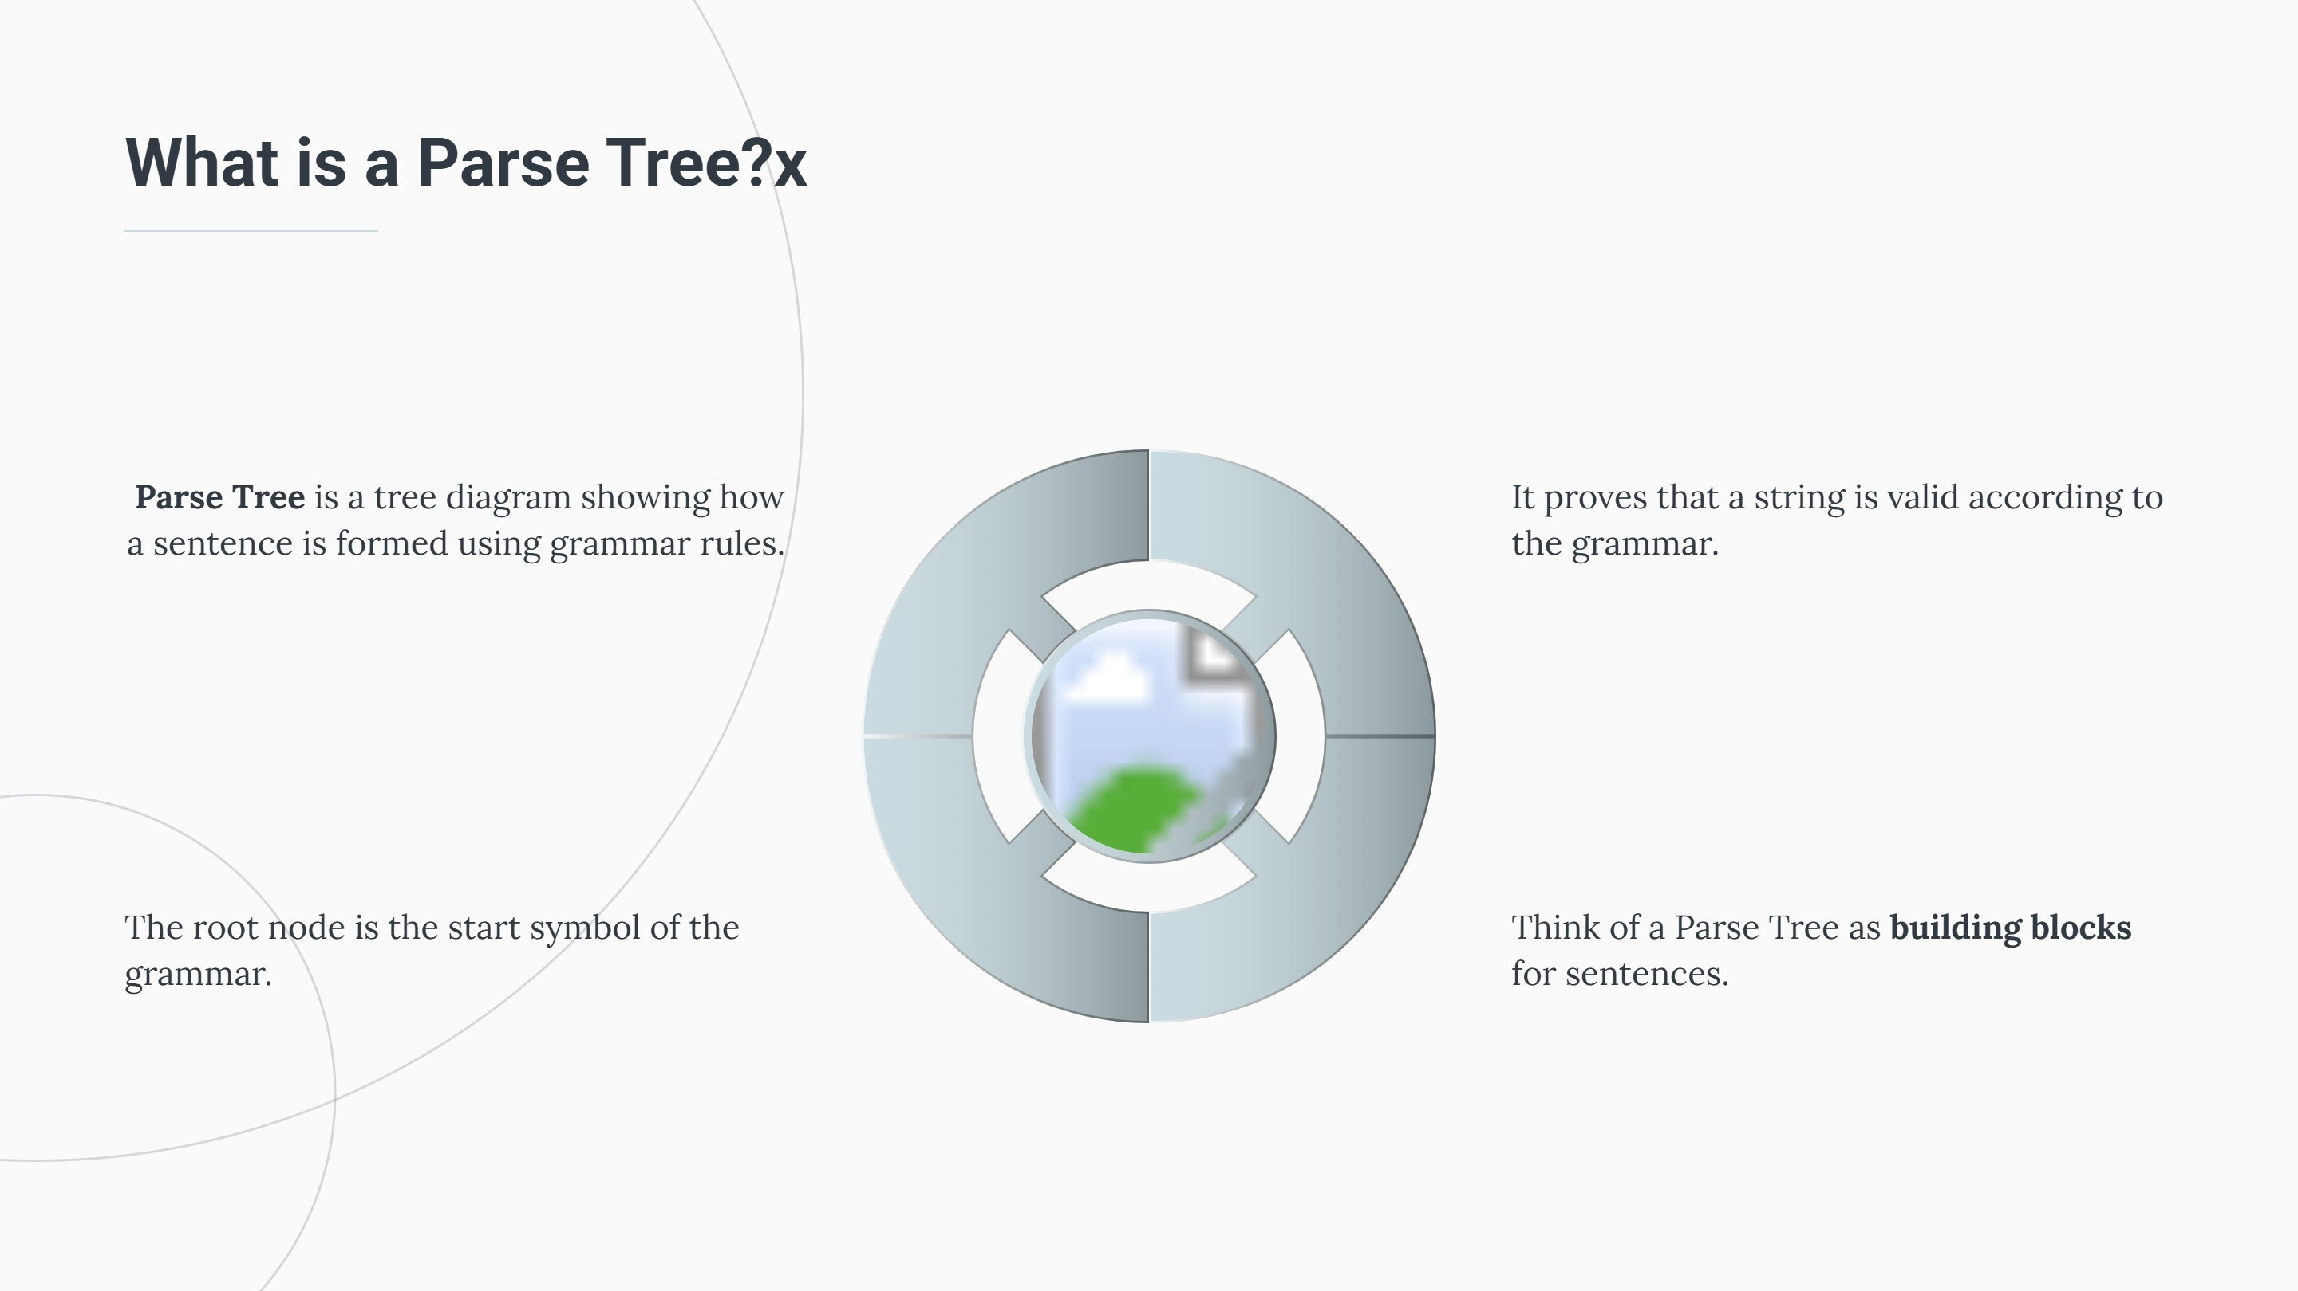

Slide 18
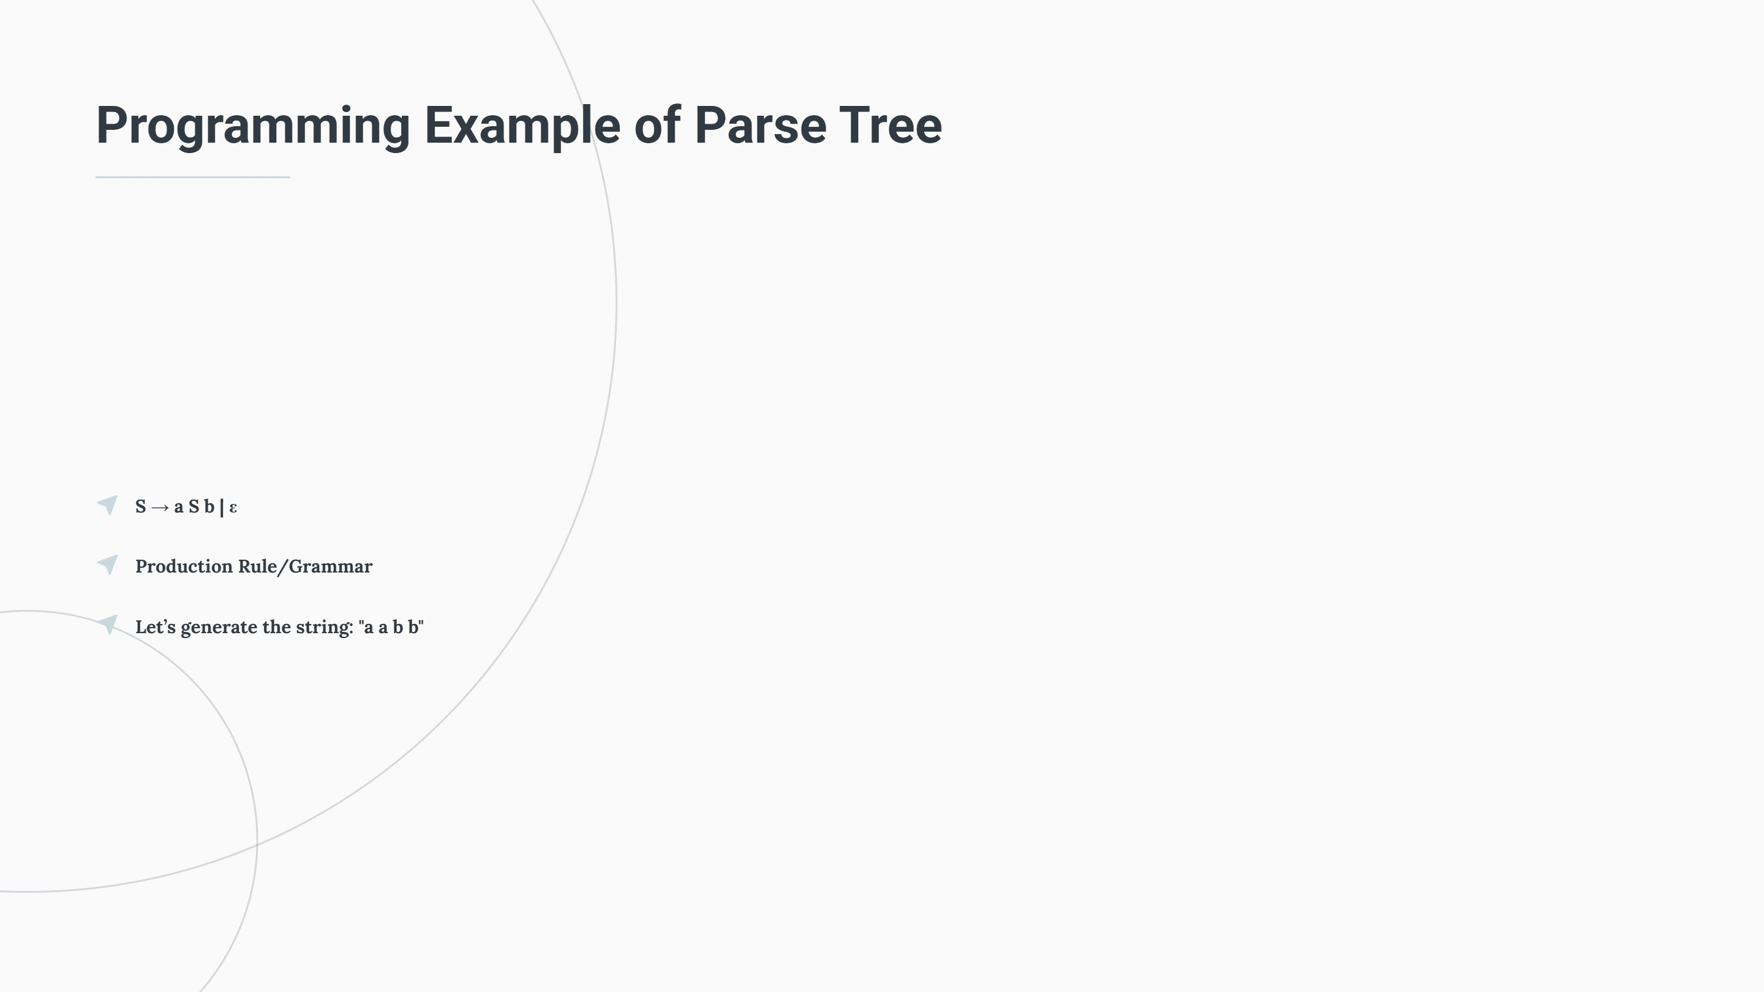

Slide 19
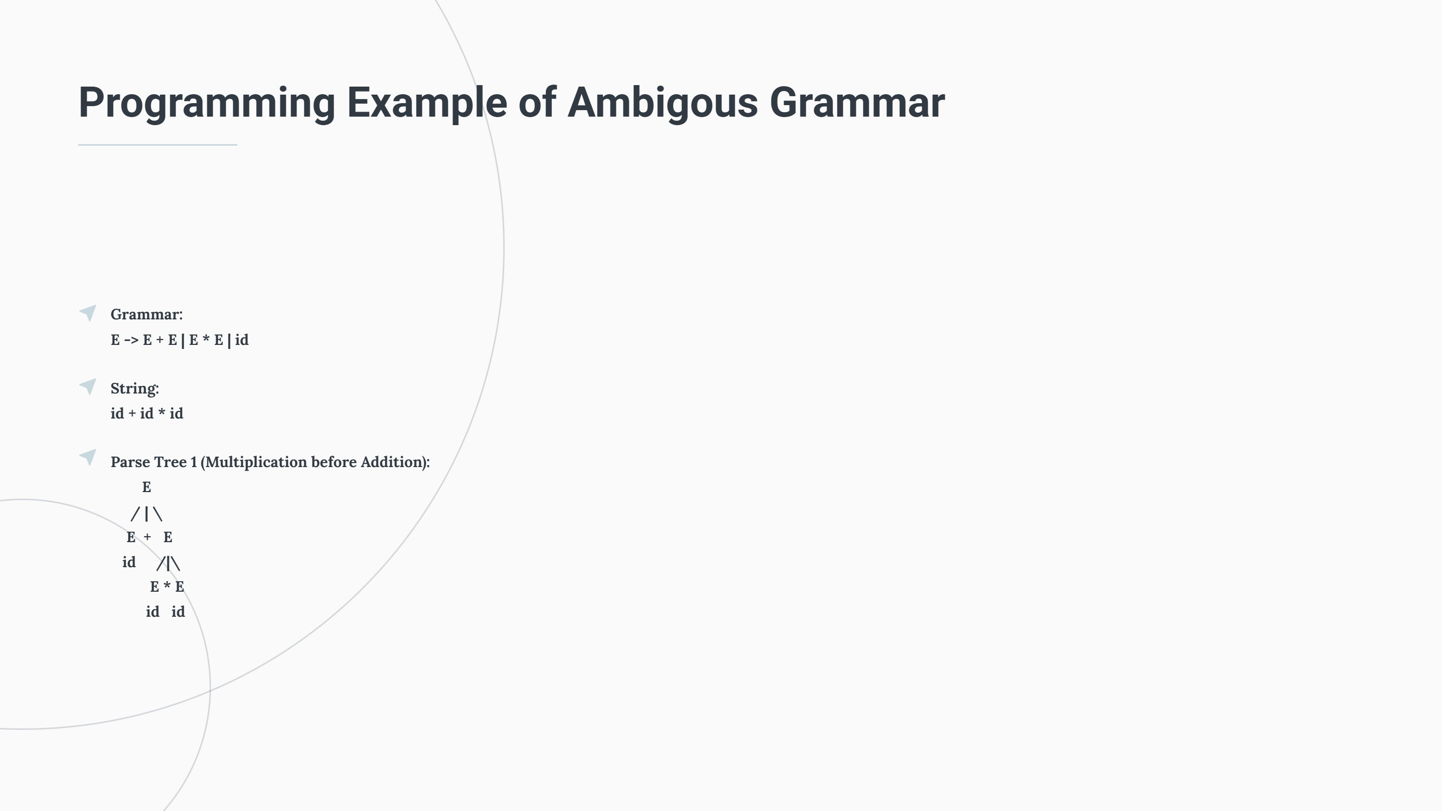

Slide 20
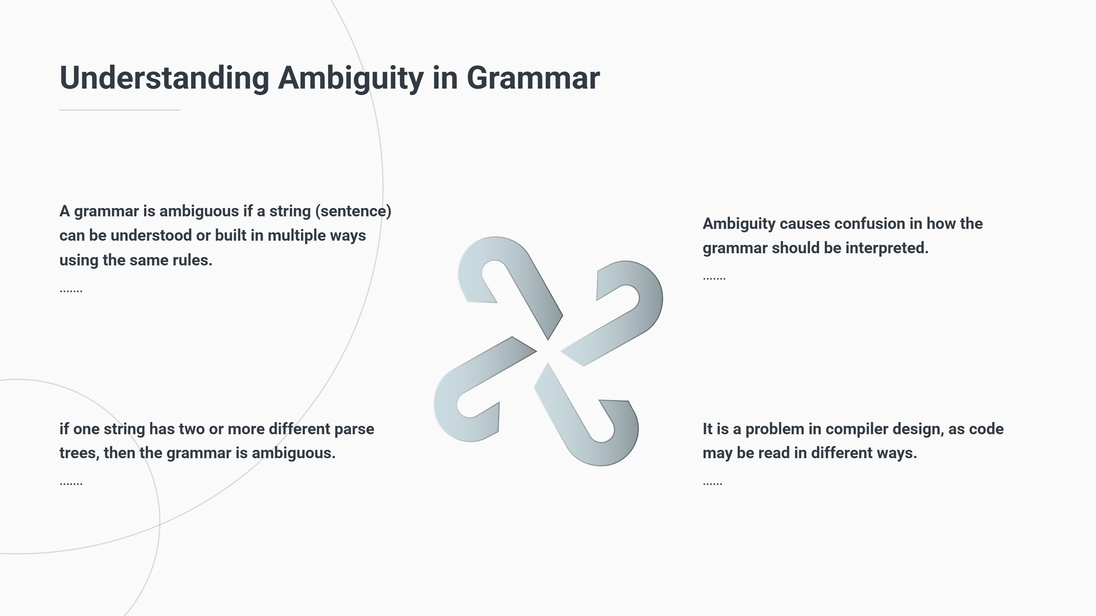

Slide 21
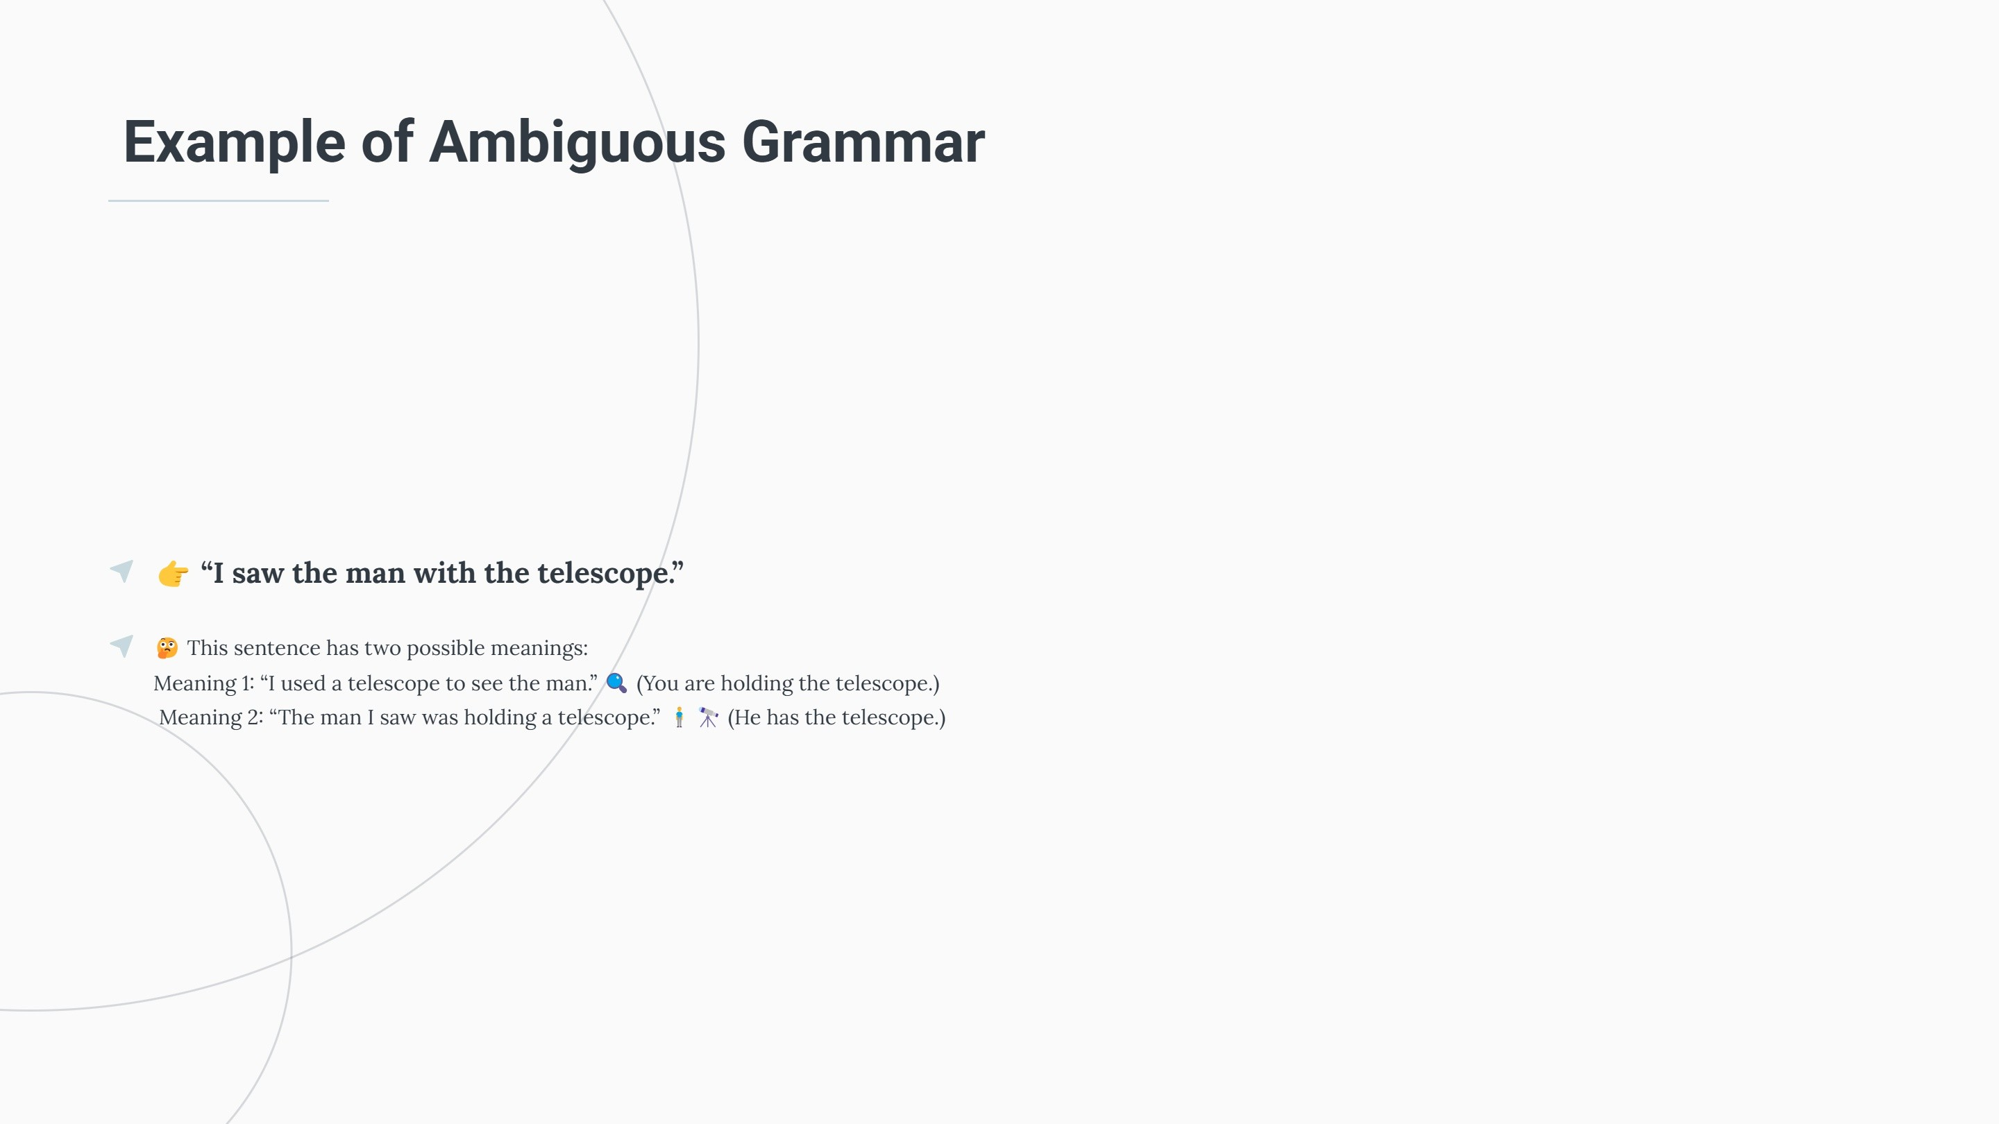

Slide 22
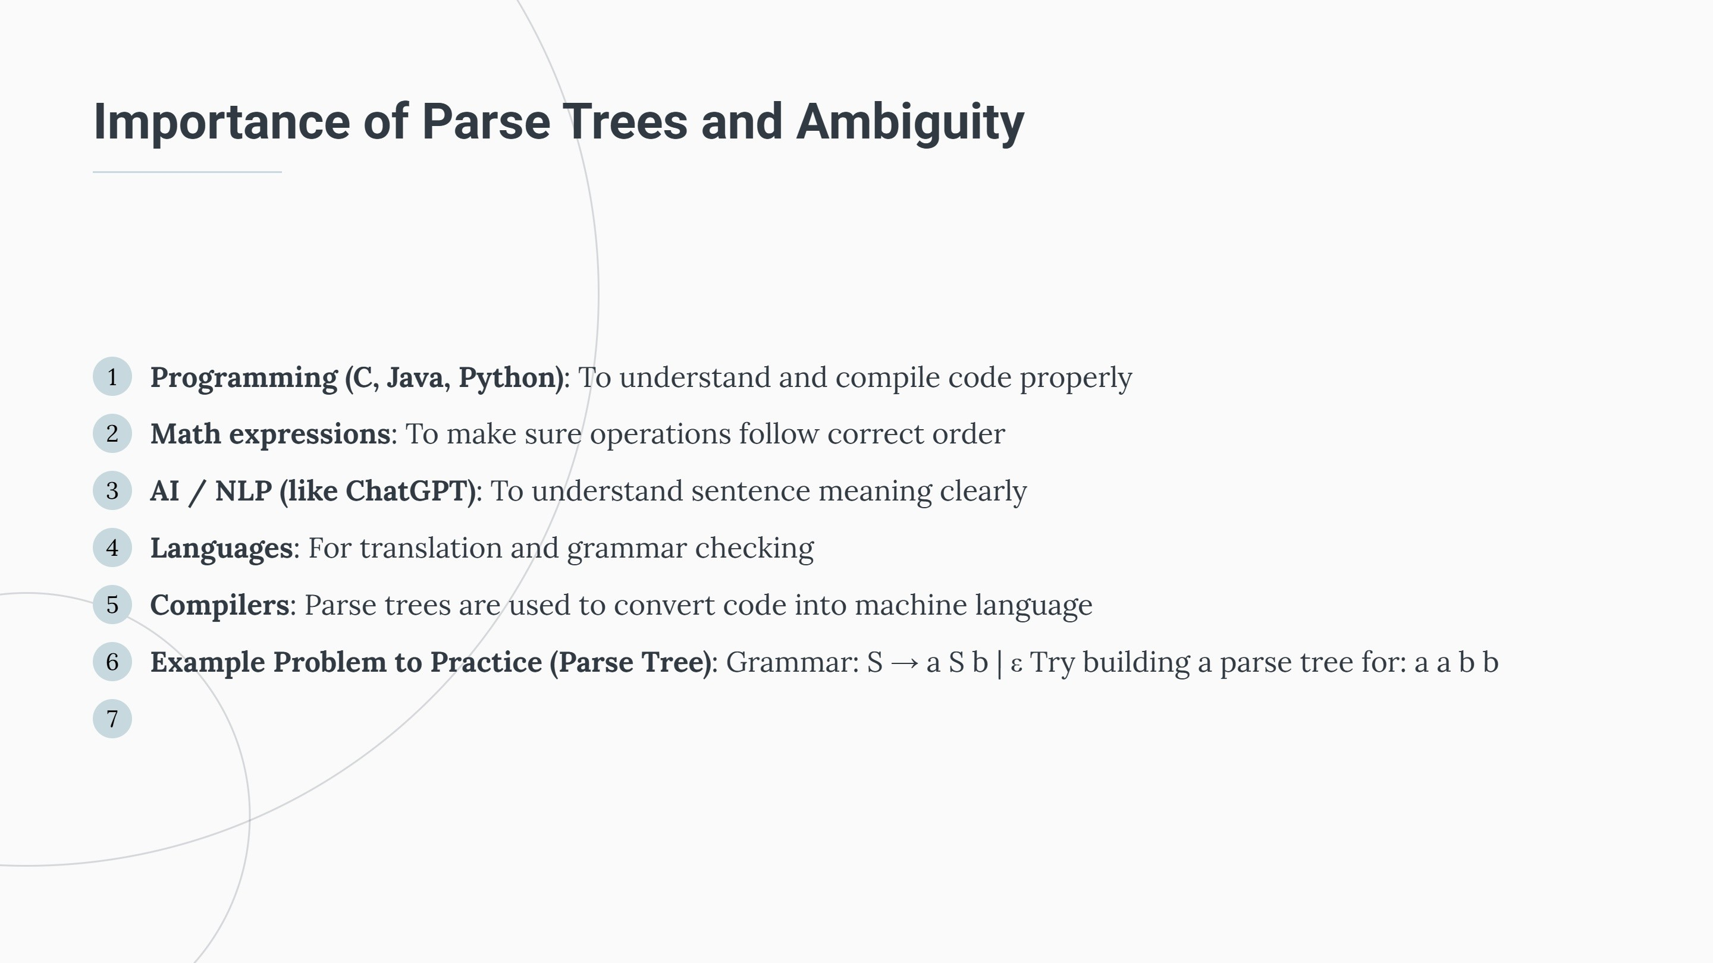

Slide 23
Thank you

